Slide 1
Children and Youth Religious Education

Slide 2
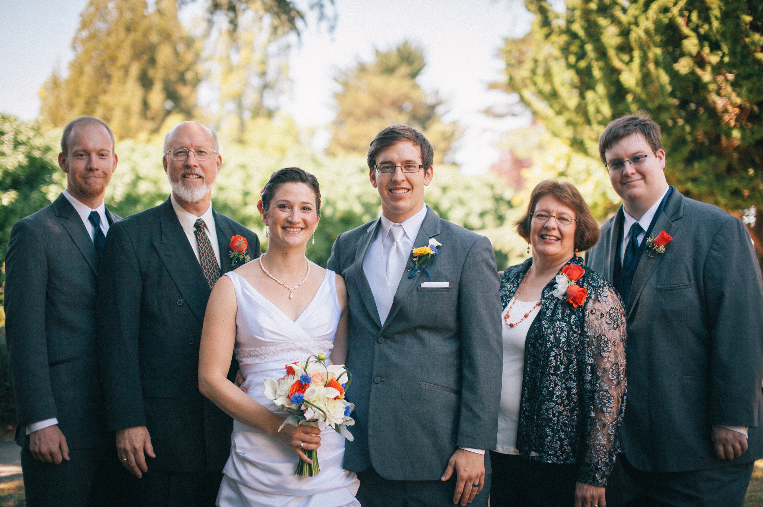
Notes:
Intro myself-

Slide 3
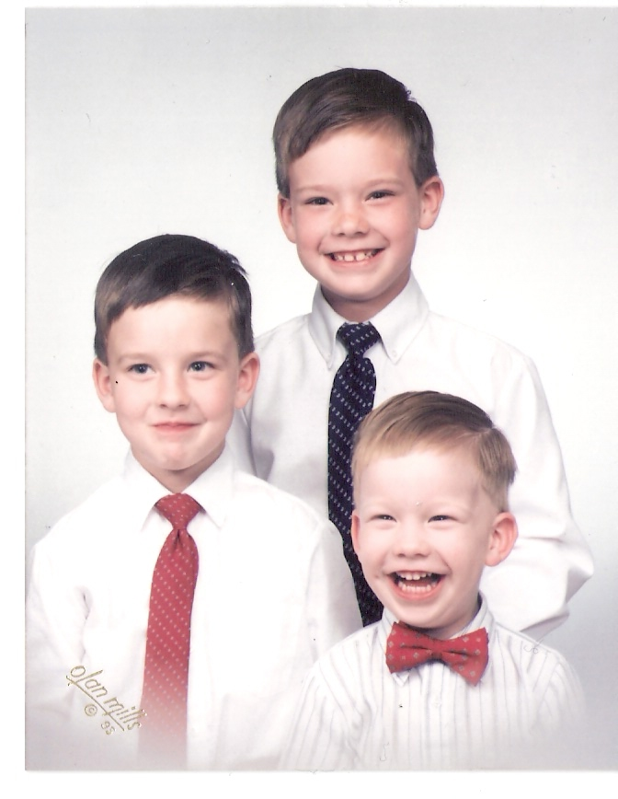
Notes:
I became a Sunday School teacher in the Bronx, NY where all 3 of our boys were born. Another sister and I-Lydia Compton were the only ones with kids so we became the teachers and learned by doing.

Slide 5
Religious/Spiritual Education
Notes:
I will use these two interchangeably

Slide 6

Spiritual Maturity
Notes:
Goal-A spiritual mature person is someone who is aware of their own divinity-Bishop Stallings-I Am Living in the rhythm of the god within, loves all people/things with God’s love, good member of the family/society/etc. and has developed his/her creative potential

Slide 7
Spiritual education is the process through which a child grows to achieve spiritual maturity.

Slide 8

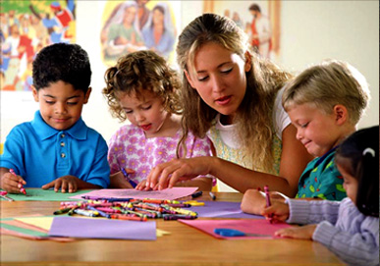
Our Role
Notes:
Be a role model-see yourself as God/TP’s representatives. We are the voice, the arms that can reach out and embrace the children and youth in our community. Realize how much HP love these children and how much he wants to give to them. Pray for guidance and believe that God is working through you. No matter how limited you may feel, when you are the teacher/educator/parent-you are the center point through whom God will work.

Slide 9
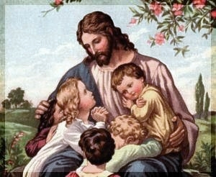
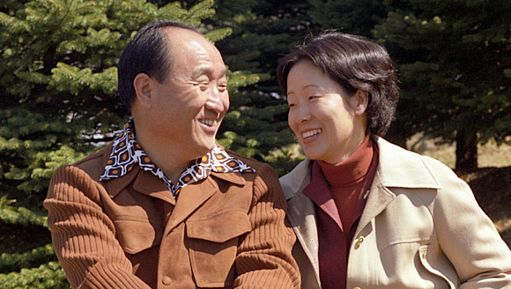
Our Role
Notes:
To provide a place where children/youth learn about biblical history and key figures in history, our church beliefs, traditions, and holy days and their importance, study Divine Principle, the Bible, other great sp. Figures and current church history

Slide 10
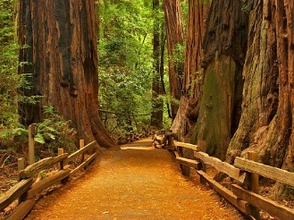
Our Role
Guiding them on the path through spiritual growth to maturity
Notes:
Beginning foundation with Bible stories and roles in the family, moving to an awareness of God working through out history in people’s lives, DP, etc. As children become teenagers, they move to a new level of developing their own life of faith. Making it relevant to daily life/application of DP, experience how God’s word brings hope and insight to meet life challenges, prep for matching and blessing.

Slide 11
Spiritual Growth
  Sensitivity to God
  Awareness of others
  Knowledge of right and wrong
  Learning to give/receive love

Slide 12
Life-long Process
    Family
    Sunday School
    Church Community
    Youth Ministry

Slide 13
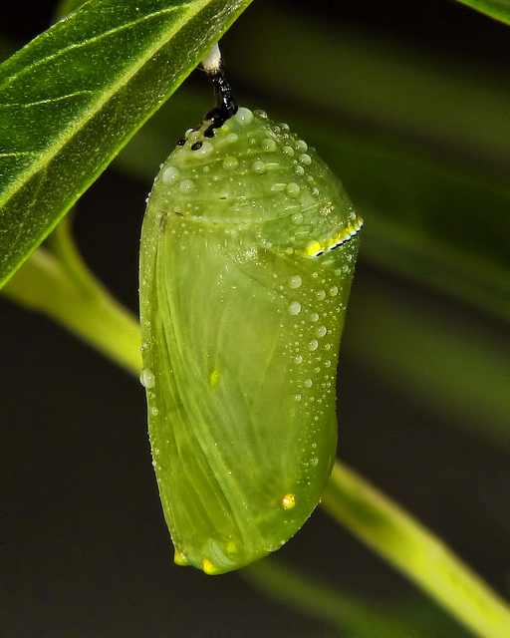
Lesson Preparation
Notes:
No matter what curriculum that you use (I will mention more about curriculum later), preparation is important. Having a good plan makes everything flow more easily. Think of what your objective is for the students. Plan out the material needed. In our classrooms, we have a SS tube in each class with basic material-paper, markers, colored pencils, scissors. If you don’t have a dedicated space, you can still have a container (with a handle) that is brought in each week. I used to have a toolbox with extra supplies-balloons, pingpong balls,

Slide 14

HOOK-interact/connect
BOOK-story/content
LOOK-activity/project
TOOK-summarize/review

Slide 15
Ways To Make
Lessons Engaging
Notes:
Use your own creativity, strengths. If you are a great storyteller, do that. Do a character performance. Juggle, use a puppet. Michael-scoutmaster. Had the 5th graders do a knot tying team building activity I like practical, visual examples. For instance-self control-not hurting others with your words-toothpaste and a paper plate. Afterwards, activity that allows the students to give acknowledge the positive aspects of each other

Slide 16
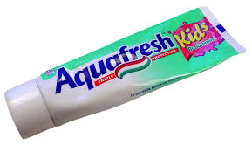
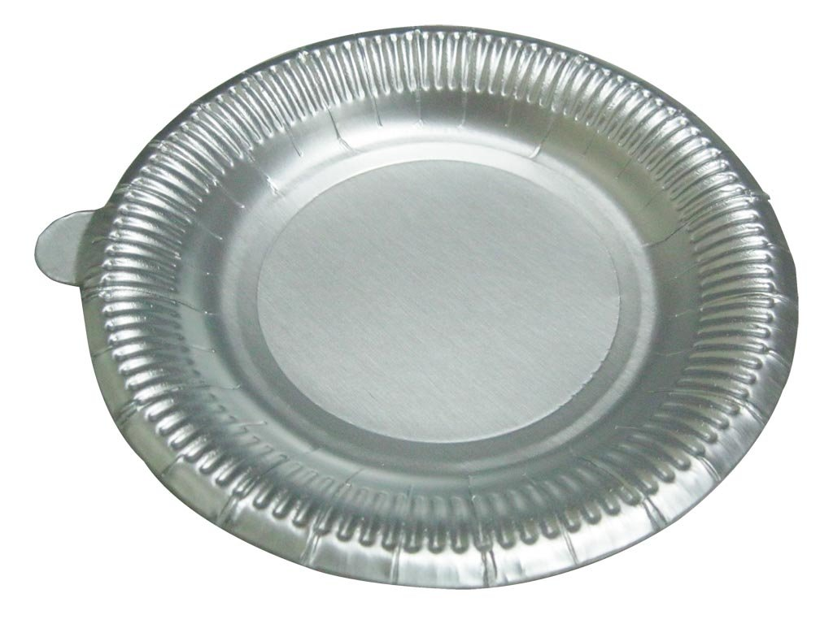
The power of words

Slide 17
Myrna
The Power of Words
musical
passionate
loyal
A good friend

Slide 18
Leaves
Notes:
Lesson on God’s creation and how uniquely he has created everything-I could take about leaves, how different they all are

Slide 19


Notes:
I could show pictures of the intricate details of some leaves

Slide 20


Notes:
Even get some beautiful color pics-but how much better would it be if I actually brought in samples and had the kids explore real leaves-looking for how they are the same and different, maybe using small magnifying glasses that I borrow from my favorite science teacher. Put them all out on a table and let kids explore and experience. Talk about your own favorite memories-racking and jumping into leaves, how they sound when you crumble a dry leaf, asking them to pick out a favorite one and do crayon rubbing by taping the leaf to the table, put paper on top, lay the crayon flat and do a rubbing of all of the veins and details.

Slide 21
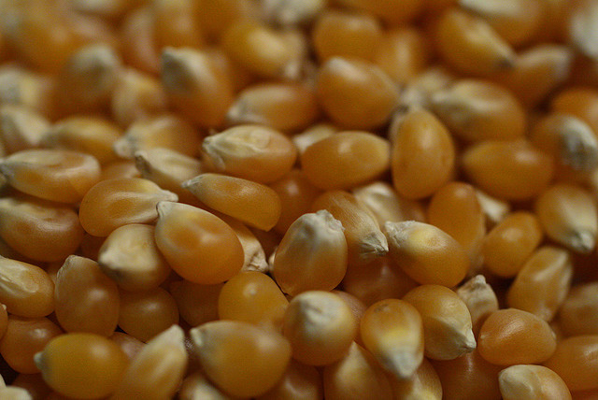

Experience the lesson
Notes:
One of favorite activities with young children is-spread out a clean sheet, ask everyone to sit around on the edge of it, put an air popper in the middle w/o the top filled with popcorn kernels and turn it on. I talk about the experience of joy and how it builds inside of us and when we are really happy, it just pops out of us. Waiting, builds anticipation, finally the first kernel pops out (have to warn everyone to sit on the edge-don’t touch any kernels that come out.) Afterwards, eat. Can use for the process of growth as well-waiting for it to happen

Slide 22
Classroom Management
Begin with a good plan
Be the subject
Different learning styles
Be age appropriate

Slide 23

Curriculum
Christian Curriculum
Route 52, Standard Publishing
Light of Glory

Slide 24
Tim Atkinson
tim.atkinson@spray.se
Notes:
English brother, graduated from the seminary 1988 living in Sweden has spent more than 20 years developing a curriculum that is age appropriate, well thought out, intertwines Bible stories, DP, TP and virtues. I purchased his curricula sent on a disk/dropbox.

Slide 25
My Book of God
3-5 years old

Slide 26
The Old & New Testament
My Journey in Life
6-8 years old

Slide 27
True Parents’ Lives & the Early Church
Principle Workbook
9-11 years old

Slide 28
Middle School Curriculum
Pilot program needs field testing
Looking teachers to use draft
Commit to give regular feedback
Email me: myrnalapres@gmail.com

Slide 29
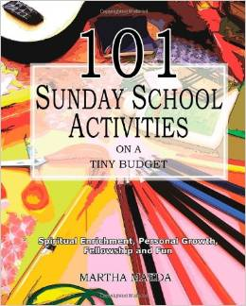
Resources
101 Sunday School
Activities on a
Tiny Budget
by Martha Maeda

Slide 30
www.maedam.wordpress.com
www.thesource4ym.com
www.youthspecialties.com
www.gameskidsplay.net
www.standardpub.com
www.wingclips.com-free
www.reverendsunmyungmoon.org

Slide 31
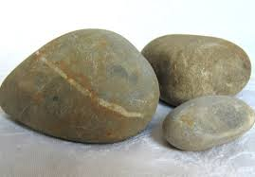
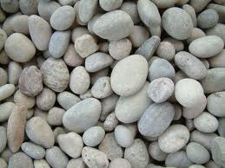
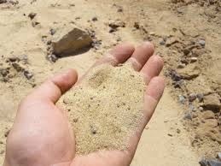
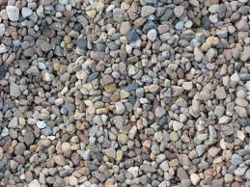

Slide 32
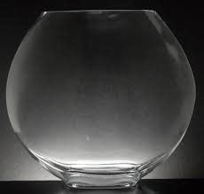

Slide 33
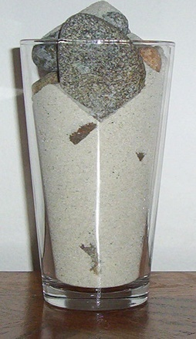

Slide 34
Put the big rocks in first!

Slide 35
Questions/Comments

