Slide 1
Blessing Prep Support Webinar
Preparing Couples for the Blessing

Slide 2
Please type your questions and we will answer them during the Q&A session at the end of the presentation.

Slide 3
Agenda
Information about the upcoming Blessing Ceremony
How to prepare couples for the Blessing
How to prepare a local Blessing Ceremony
Q&A

Slide 4
Blessing Timeline
Blessing Date – Morning of March 3rd in Korea
    Evening of March 2nd in the U.S.
Blessing Application Deadline – Feb. 1st, 2015
Korea Travel Grant Application – Jan 11th, 2015

Slide 5
Ministry Leaders Resources
https://bfm.familyfed.org/5-ministry-leaders-resources/

Slide 6
Preparing Married Couples
Explanation of the 5 Steps to Change of Blood Lineage
https://bfm.familyfed.org/becoming-a-blessed-couple/

Slide 7
Preparing Matched Couples
Blessing Interview
Matching Report
Individual & Couple Photos
Level 3 Blessing Education: Start Smart!
  Requirement for the Blessing
  Designed for couples preparing for married life
  Participation can be at live Workshops
      Jan. 9–11 at Bay Area Family Church, CA
      Jan. 23–25 at UTS, NY
      Or, Online Course

Slide 8
Matching & Blessing Applications
1. Matching Candidate Application
2. Matching Report Application
3. Blessing Ceremony Application
Q: “What if a couple is already matched?”

Slide 9
Matching & Blessing Application
https://bfm.familyfed.org/online-matching-blessing-application/

Slide 10
How to Apply
For Matched Couples
  1. Matching Candidate App.
  2. Matching Report App.
  3. Blessing Ceremony App.
For Married Couples
  3. Blessing Ceremony App.
For those interested in the Cheon Il Guk Matching
  CIG Matching Orientation – Nov. 8
  1. Matching Candidate App.
  3. Blessing Ceremony App.

Slide 11
Blessing Ceremony Application
New system
Serves U.S. and Canada
Needed info for matched couples:
  Level 3 Blessing Education certificate
  Flight information (if traveling to Korea)
  Blessing Offering (via PayPal)
Needed info for married couples:
  Local UC connection
  Marriage Certificate
  Blessing Offering (via PayPal)

Slide 12
Blessing Ceremony Application
https://bfm.familyfed.org/test-form-1/

Slide 13

Participating in Korea
  Korea Blessing Experience package (3 - 5 days total)
    March 1: Arrival & Registration
    March 2: Pre-Blessing education
    March 3: Blessing Ceremony with True Mother & Post-Blessing Celebration
    March 4: Couple Sightseeing
    March 5: Return home
  How to apply
    Online Blessing Ceremony Application

Slide 14
Participating in Korea
  Korea Travel Grant
    To support couples with travel expenses
    Offered by U.S. FFWPU and Canada FFWPU
    $500 towards per individual legally residing in the U.S. or Canada
    Application Deadline – Jan. 11
    Once approved, recipient will receive $500 deduction from Blessing Offering amount

Slide 15
Korea Travel Grant
https://bfm.familyfed.org/apply-korea-travel-grant-2015-7379/

Slide 16
Cheon Il Guk Matching
  Qualifications for eligible participants outlined on BFM site
    20 -30 years of age, no dating experience, ready to make an absolute commitment, prepared to invest in an international relationship
  Cheon Il Guk Matching Orientation Virtual Meeting
    Saturday, Nov. 8 (12pm–7pm)
      All interested candidates and parents are welcome

Slide 17
CIG Matching Orientation
https://bfm.familyfed.org/upcoming-cheon-il-guk-matching-orientation-•-nov-8-•-127pm-est-7512/

Slide 18
Participating Locally
  How to apply
    Online Blessing Ceremony Application
    Connect with local/district Pastor

Slide 19
Participating Locally
  BFM support for local Blessing Ceremonies
    Finances
      Up to $500 subsidy per individual
    Promotion
      National promotion for local ceremonies
      Local Blessing webpage (deadline: one week, Nov. 6)
        Email: buyama@unification.org
      Witnessing tools to invite married couples to the Blessing

Slide 20
Participating Locally
  Holy Wine
    Foundation Day Holy Wine

Slide 21
Blessing Offering
$2,000 for individuals who will attend the Blessing Ceremony in the USA
$1,500 for individuals who will attend the Blessing Ceremony in Korea
$500 for individuals who originally paid $2000 and will attend the Blessing in the USA
$600 for individuals who originally paid $2000 and will attend the Blessing in Korea
$2,000 for Married Unificationist Couples
$210 for Married Non-Unificationist Couples

Slide 22
Blessing Offering
https://bfm.familyfed.org/0-blessing-offering/

Slide 23
Verification of Nationality & Visa Status
https://bfm.familyfed.org/required-documents-for-matching-blessing-applications/

Slide 24
Creating a Team
Event Coordinator
  Ex: Pastor, Assistant Pastor, Youth Pastor, Sunday Service Coordinator
  Co-Coordinators
Couple Tracker
  Support and keep track of couples who will participate

Slide 25
Creating a Team
Volunteers
  Promotion
  Ushers
  Registration
  Decoration
  Accommodation
  Dinner/Refreshments
  Technician
  MC
  Photographer
  Entertainment!

Slide 26
Level 2 Curriculum
Level 2 Blessing Education: Preparing for Marriage
  Requirement for the Blessing
  Local workshop package available soon:
    1. Awesome presentations
      What do I bring to the table?
      Matching Smarts
      Getting Real
      My Heritage, My Legacy
      Understanding the Matching Process
    2. Instructor’s manual
    3. Supporting documents
    4. $120 on HSAbooks.com ($60 for pastors and ministry leaders)

Slide 27


Slide 28
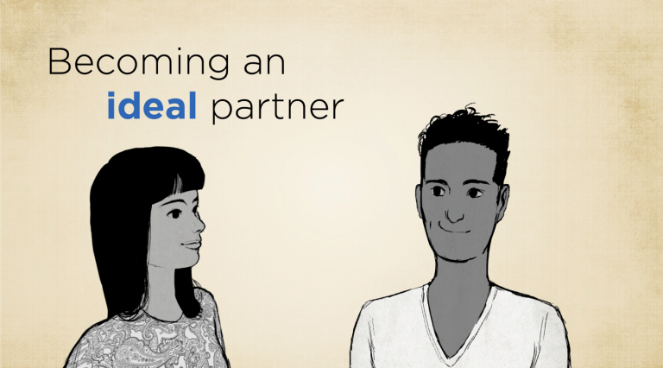

Slide 29


Slide 30
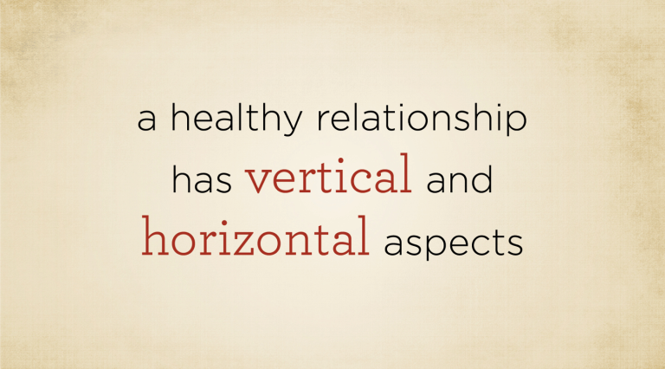

Slide 31


Slide 32
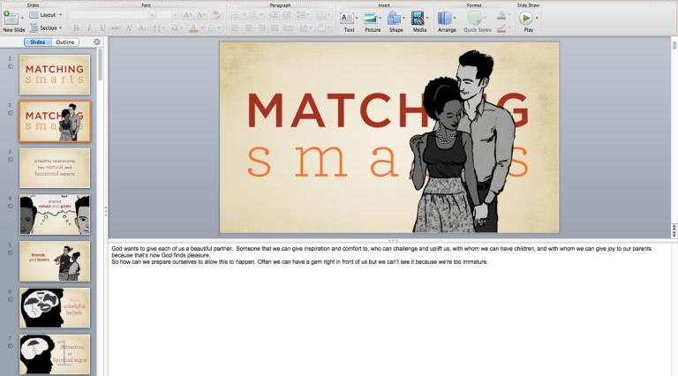

Slide 33
Next Webinar
Conducting a Blessing Ceremony
Dec. 18
  Blessing Ceremony format and schedule
  Explanation of Blessing documents and items
  Distribution of Blessing documents
  Testimony from successful Blessing Ceremony
  Q&A
  Register for the next webinar: https://www1.gotomeeting.com/register/451862896

Slide 34
Q&A

